Slide 1
National Development Forum 2024:
Human Capital and Sustainable Development
Улуттук өнүгүү форуму 2024:
Адам капиталы жана туруктуу өнүгүү
Стратегия-2030: Кыргыз Республикасын
өзгөртүүдө адам капиталынын жаңы сапаты
Амангельдиев Д.Дж.
Кыргыз Республикасынын
Экономика жана коммерция
министри
2024-ж 4-ноябры
STRATEGY-2030:
A new quality of human capital in transforming the Kyrgyz Republic
Amangeldiev D.Dzh.
Minister of Economy and Commerce of the Kyrgyz Republic
November 4, 2024

Slide 2
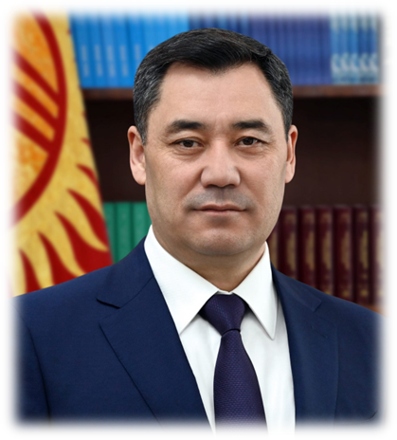
«Human resources are our greatest wealth... Investments in human capital will yield dividends in the future not just tenfold, but at least a hundredfold»
© Sadyr Japarov

Slide 3
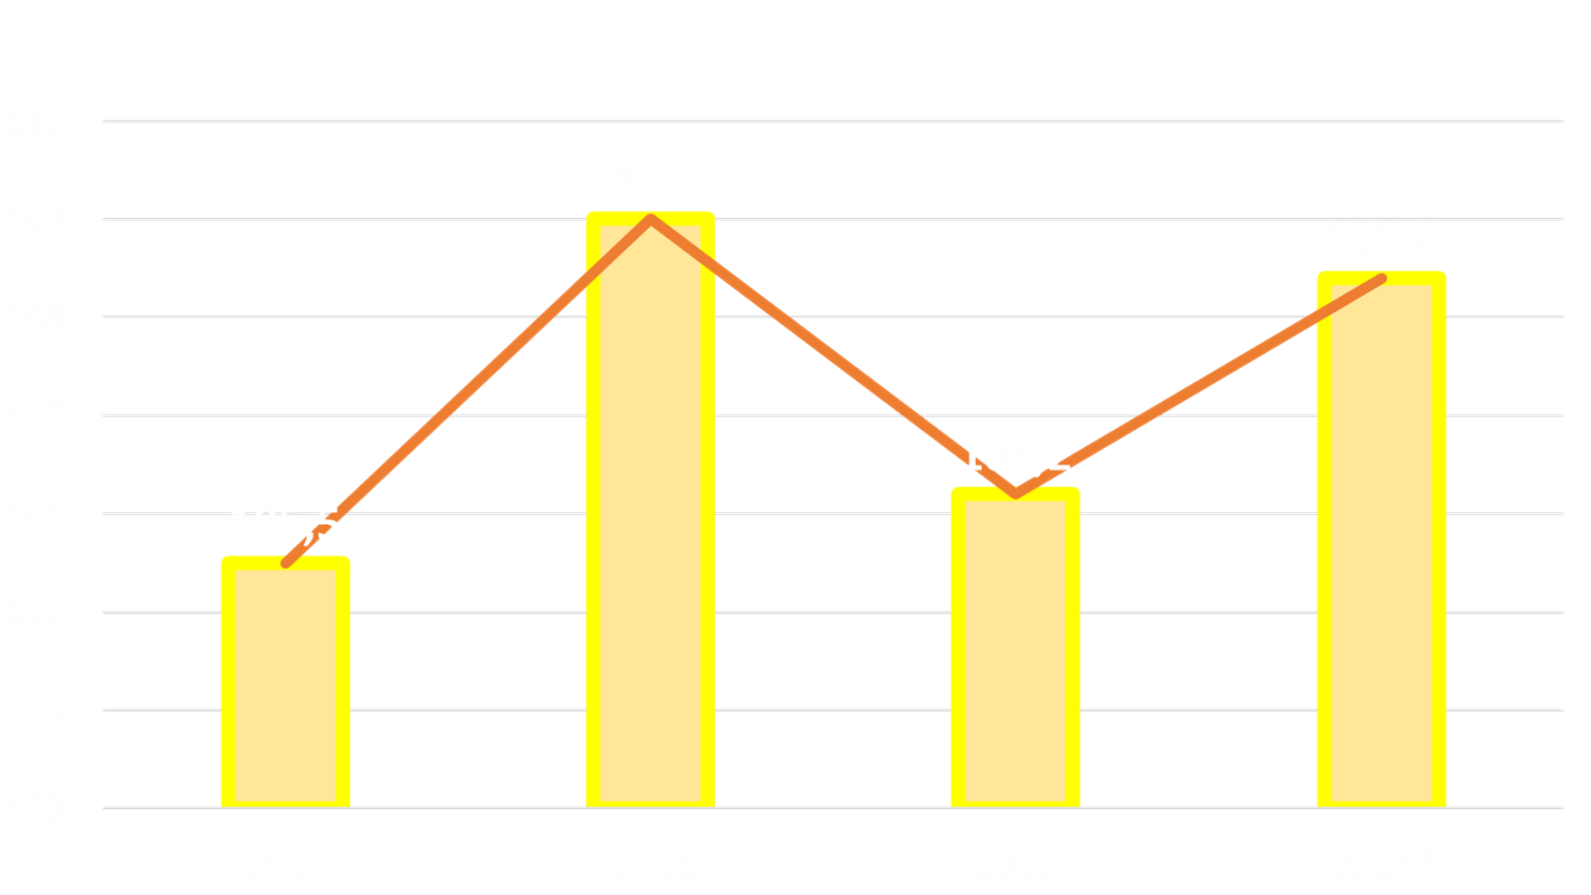
MACROECONOMIC INDICATORS
Economic Growth Rate
ECONOMIC GROWTH FROM 2021 TO 2024 (9 MONTHS) INCREASED BY AN AVERAGE OF 6.9%

Slide 4
CONTRIBUTION OF LABOR AND CAPITAL
2021
2023
2022
2024

Slide 6
NATIONAL DEVELOPMENT PROGRAMME OF THE KYRGYZ REPUBLIC UNTIL 2030
Industrialization
Goals:
To increase GDP to 30 billion US dollars
Export
The budget deficit is no more than 3%
Kambar-Ata-1
To be in the top 30 countries in SDG implementation
China-Kyrgyzstan-Uzbekistan Railway
Financial-industrial clusters

Slide 7
FURTHER PLANS
Qualification development and retraining programme
Entrepreneurship Development Support Fund
Attracting qualified personnel
Migration policy

Slide 8
THANK YOU FOR YOUR ATTENTION!

