Slide 1
Global Trends, Risks and Opportunities for the Kyrgyz Republic
Kazutoshi CHATANI
Senior Employment Specialist, ILO

Slide 2
Global trends in the world of work
Patchy recovery from the pandemic
A recovery with widening income gaps
The global unemployment rate is projected at 4.9 % in 2024, slightly lower than in 2023 (5.0%)
The global labour income share, which represents the portion of total income earned by workers, fell by 0.6 percentage points from 2019 to 2022 and has since remained flat
While technological innovations enhance labour productivity and output, they can also reduce the labour income share
Protection of gig-/platform-works is a subject of global debate
Persistent gender gaps
The female youth NEET rate at 28.2 % in 2024 – is more than double that faced by young men at 13.1%
69.2% of men (age 15+) are employed, but only 45.6% for women
Women's earning is 73% of men in high-income countries, 43% in low-income countries
Despite solid economic growth, informal employment has increased
Informal employment has grown from about 1.7 billion in 2005 to 2.0 billion in 2024

Slide 3
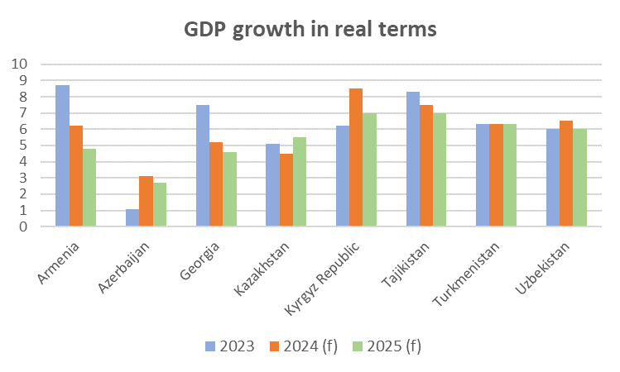
Top risk to the Kyrgyz Republic: Decent work deficit for the growing educated youth population
Source: EBRD (2024) Regional Development Prospect May 2024
Source: ILO (2024) Global Employment Trends for Youth 2024, ILO STAT
Note: Central and Western Asia include Armenia, Azerbaijan, Cyprus, Georgia, Israel, Kazakhstan, Kyrgyzstan, Tajikistan, Türkiye, Turkmenistan, and Uzbekistan

Slide 4
Investment,
Business expansion
Income effect on aggregate demand
Technologies, productivity
Economic growth
Labour demand
Informality
Creation of
Decent Work
Inter-
mediation
Job matching efficiency
Skills mismatch
Unequal access to jobs
Labour supply
Labour mobility, migration
Activation
Sector shift, Churning
Skills development

Slide 5
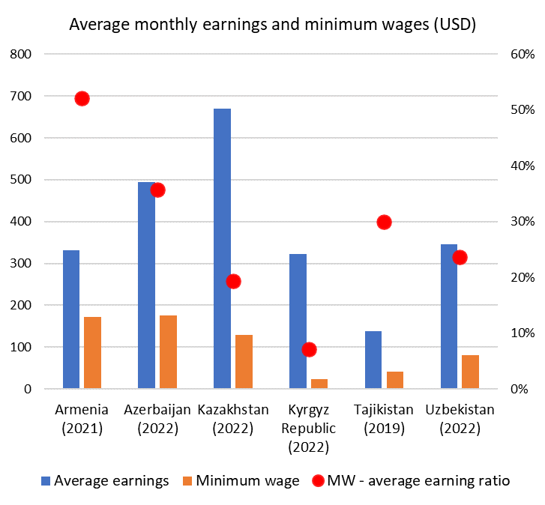
Opportunities:
Improving income distribution
Minimum wage could be used to improve income distribution
and support the aggregate demand
Real wage growth was negative due to high inflation in most countries in 2022, which affected lower-income earners in particular
Minimum wage, progressive tax, social protection and other social policies can reduce income inequality
Minimum wages in the region are kept low relative to the average earnings
Minimum wages are often above 35% of the median wage

Slide 6
Opportunities:
Skills development capacity of the private sector
Engage enterprises in the governance and delivery of skills development
19%
Return on investment achieved at the third year
Source: Rothboeck (2014) Using Benefit Cost Calculations to Assess Returns from Apprenticeship Investment in India: Selected SME Case studies
£16-21
The net present value to the economy per £1 of government spending on apprenticeships.
Source: National Audit Office (2012) Adult apprenticeships: Estimating economic benefits from apprenticeships –Technical paper
Fiscal space for skills development faces constraints. Optimise responsibilities for skills development and cost distribution among the government, employers and workers.
In this light, consider skills councils and work-based learning (WBL), especially apprenticeships.
WBL is known to help school-to-work transition of youth and brings a high return on investment, but it has not taken root yet in this region
ILO Recommendation concerning quality apprenticeships (No. 208) sets key principles and provide guidelines

Slide 7
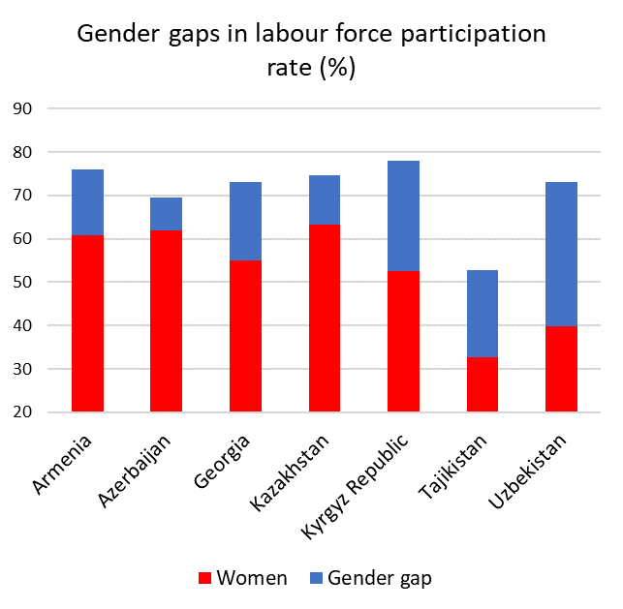
Opportunities:
Tapping under-utilised women’s potential
Actions to improve equality in the labour market
Challenge deep-rooted social norms and practices that prevent women from reaching their full potential
Invest in the care economy and leave policies (paternity leave)
Encourage a fair and equal distribution of care responsibilities between men and women
Address gender pay gap between men and women, high level informality, discrimination and V&H in the world of work
Address occupational segregation by gender
The UN Convention on the Rights of Persons with Disabilities upholds the right of PwD to work, on an equal basis with others, including equal treatment and reasonable accommodation (Article 27)
Build capacity of public employment services and promote partnerships with NGOs for labour market integration of PwD and women
Source: ILO STAT, the latest available data (2016-2022)

Slide 8
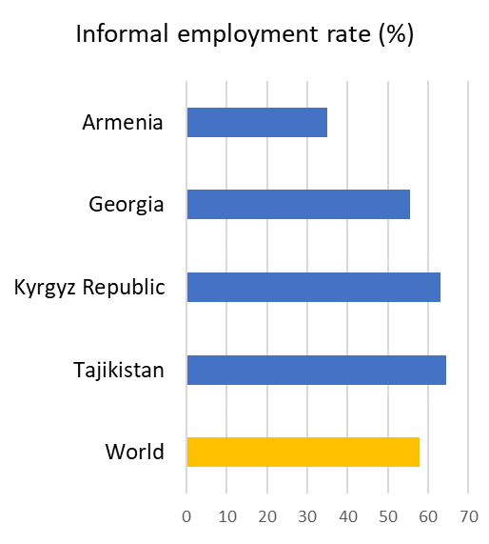
Opportunities:
Addressing informality
Tap opportunities for e-formality and broaden tax-base
Despite solid GDP growth, informal employment rates remained stable in many countries
First informal job increases the probability of staying in informal employment. School-to-work transition matters
The utilization of digital technologies can facilitate the transition to formality by
simplifying registration of enterprises and employment
facilitating access to social security
supporting compliance with laws
integrating government databases (e.g., tax, social security, worker registration) and planning targeted interventions
improving access to markets and skills development
Source: ILO STAT

