Slide 1
Temporary Migration: Challenges, Opportunities and Policy Solutions Case of the Kyrgyz Republic
Laurent Loic Yves Bossavie
Oraz Sultanov

Slide 2
Background: International migration within the broader employment context
International migration is a major source of employment for youth
It is a tremendous source of income for the country
Provides employment opportunities to workers who would otherwise be unemployed at home
Workers who migrate experience large wage gains
Remittances contributed to over 30% of the GDP 2022
However, its economic potential remains partly untapped
Migration is a one of the solutions to the jobs problem
International migration currently involves several inefficiencies and vulnerabilities
Making migration more productive could yield tremendous additional benefits for migrants and the home country
The large-scale emigration of workers from the Kyrgyz Republic is a symptom of insufficient domestic job creation
It can be an effective strategy to access better employment opportunities for a large share of the population in the short to medium term
While making migration more productive, policy reforms that support domestic employment creation are essential to address structural jobs challenges in the medium to long run

Slide 3
Data source: The Kyrgyz Migration Survey 2022/23
Motivation: Available nationally-representative datasets in Central Asia lack granular information on labor migration
Developed with Kyrgyz Government (Ministry of Labor, Central Bank, Statistical Office)
Nationally representative of households in the Kyrgyz Republic
Oversampling of households with a current or return migrant
5,500 households; 20,000+ individuals
Detailed information about domestic and foreign employment history of all adults
Includes absentees for work abroad (contacted by phone)
Includes return migrants (who went abroad for work in the past)
Looks at the entire migration life cycle (pre-departure, during migration and after return).

Slide 4
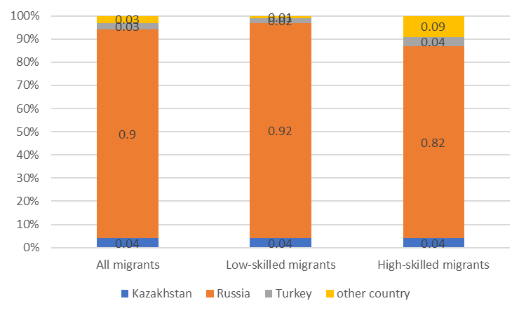
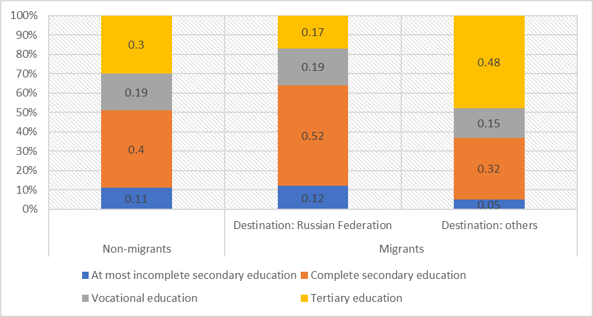
Migration is mostly low skilled and highly concentrated to Russia
Vast majority of migrants go the Russian Federation
Migration to the Russian Federation is lower-skilled than to other destinations
Distribution of migrants from the Kyrgyz Republic by destination country
Skill profile of workers from the Kyrgyz Republic, by international migration status
Source: World Bank Kyrgyz Migration Survey 2022/23

Slide 5
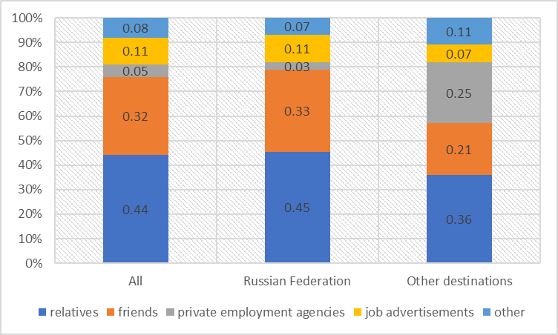
Migration channels remain largely informal
Sources of information about international migration are largely informal, especially about migration to the Russian Federation
Formality and usage of pre-migration services is very low, especially among migrants to the Russian Federation
Main source of information about employment abroad
Source: World Bank Kyrgyz Migration Survey 2022/23

Slide 6
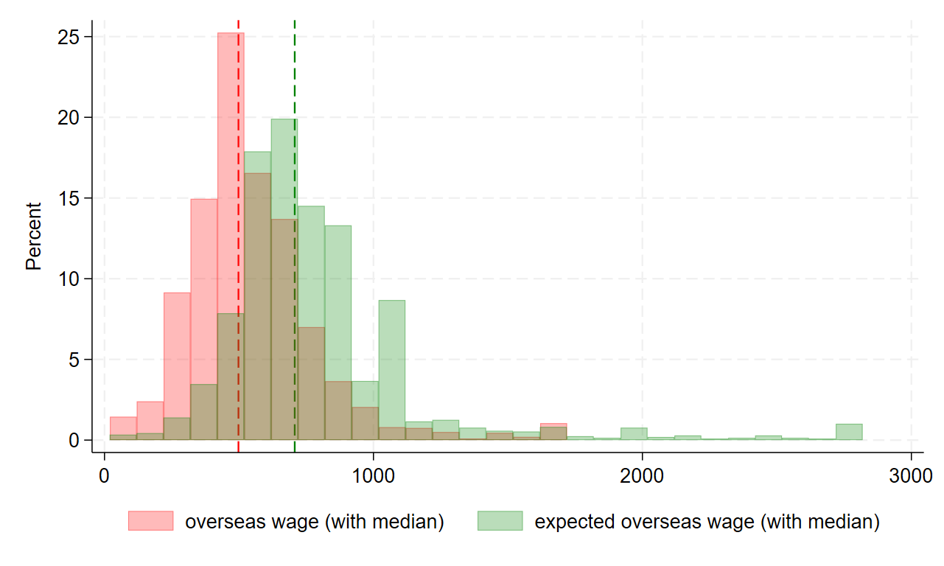
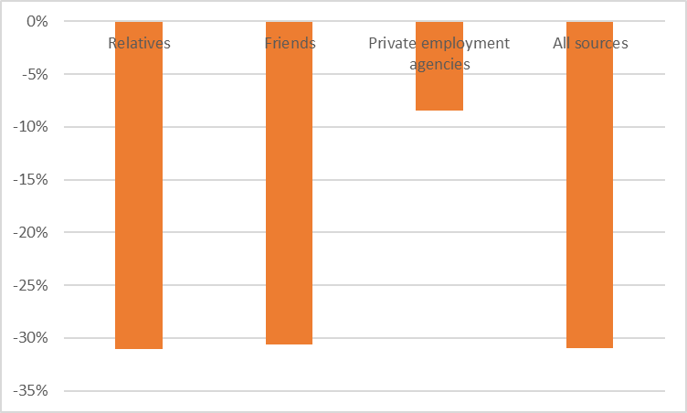
Migrants have inaccurate information about the wage gains expected from migration
Migrants overestimate wages to be earned abroad by over 30 percent
Migrants who use formal channels of information have more accurate expectations about wages abroad
Monthly wages (in USD) expected before departure compared to actual wages earned abroad
Gap between wages earned abroad and wages expected prior to departure (as % of expected wages), by source of information
Note. Vertical dashed lines denote median values
Source: World Bank Kyrgyz Migration Survey 2022/23

Slide 7
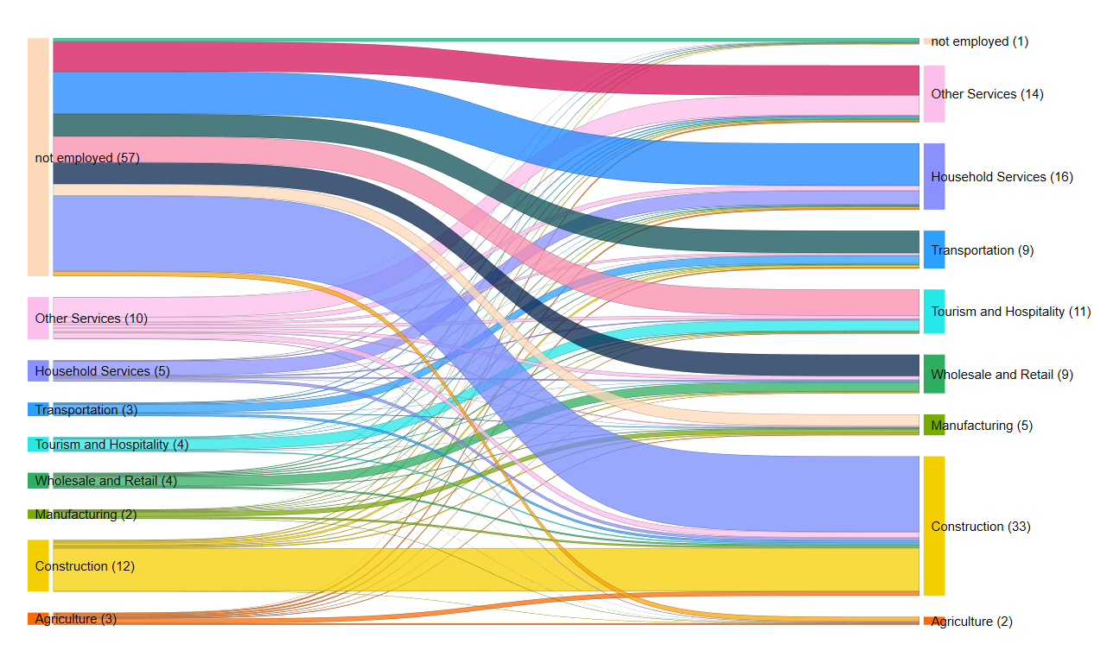
Migration enables workers who were not employed at home to find employment
Occupation of migrants before and during their migration experience
Before migration
During migration
Source: World Bank Kyrgyz Migration Survey 2022/23

Slide 8
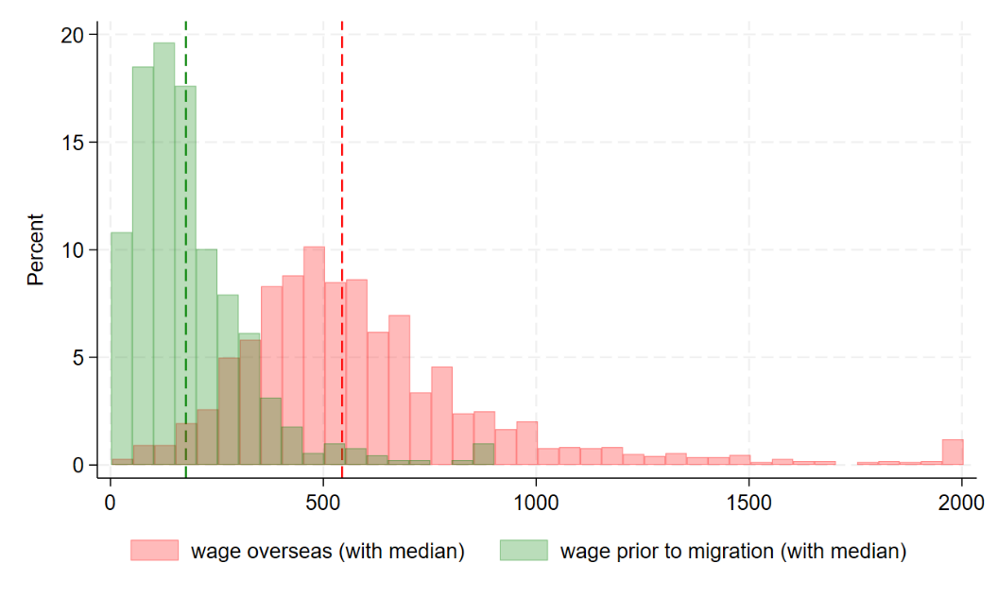
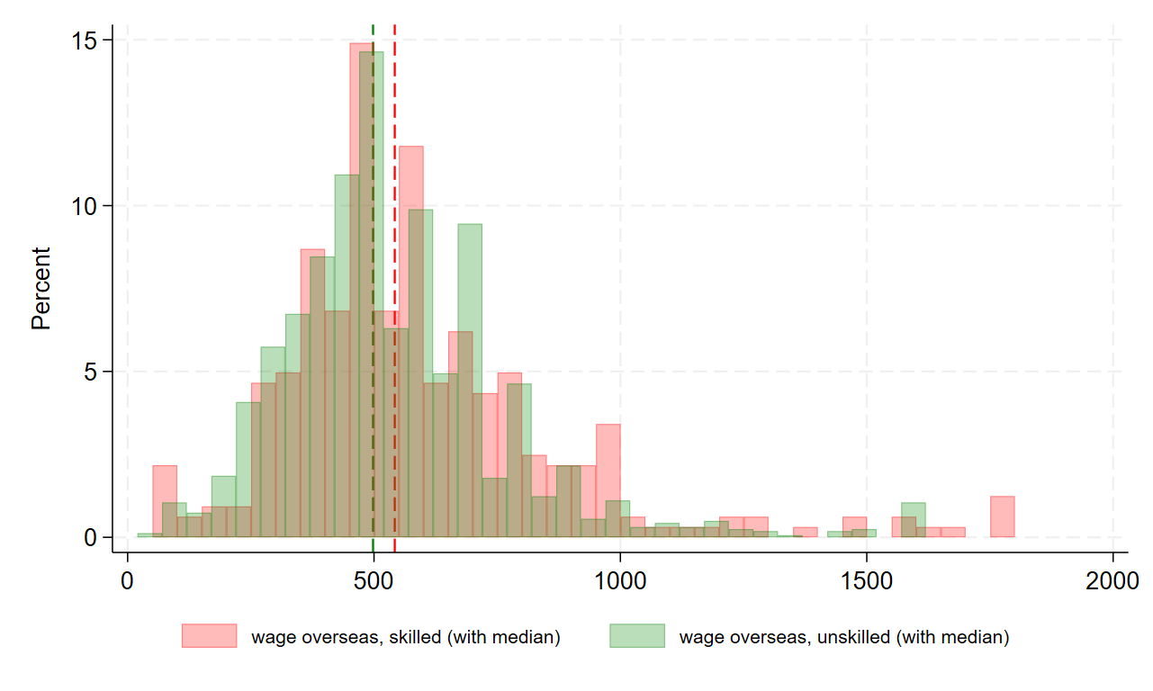
Migrants experience large wage gains while abroad, but the returns to higher skill levels are low among migrants
Migrants earn 2.5 times more abroad compared to before departure
Low-skilled and high-skilled migrants earn very similar wages abroad
Returns to tertiary education are low among migrants
Monthly wages abroad (in USD) compared to pre-migration wages
Distribution of wages abroad, by skill level
Note. Vertical dashed lines denote median values
Source: World Bank Kyrgyz Migration Survey 2022/23

Slide 9
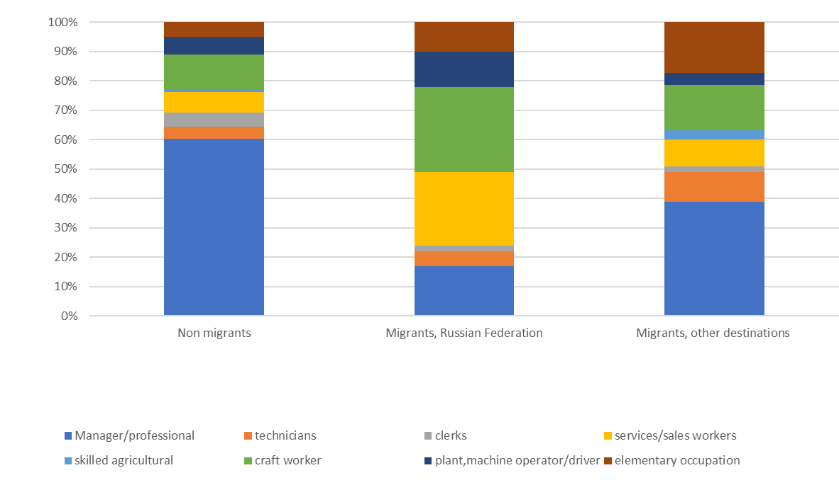
Migration also comes at the cost of occupational downgrade and potential skill waste
Migrants are way less likely to be employed in white-collar occupations abroad compared to non-migrants, especially if high-skilled
Occupational downgrade after moving abroad
Source: World Bank Kyrgyz Migration Survey 2022/23

Slide 10
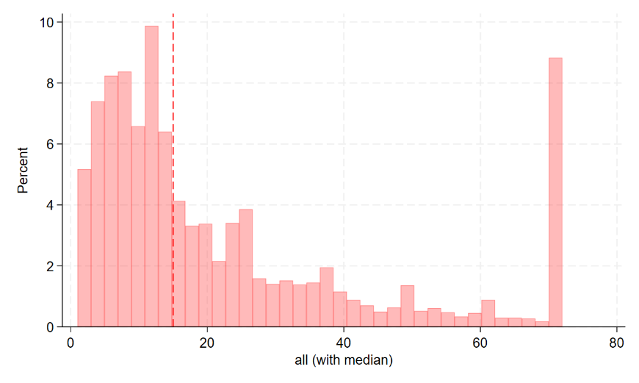
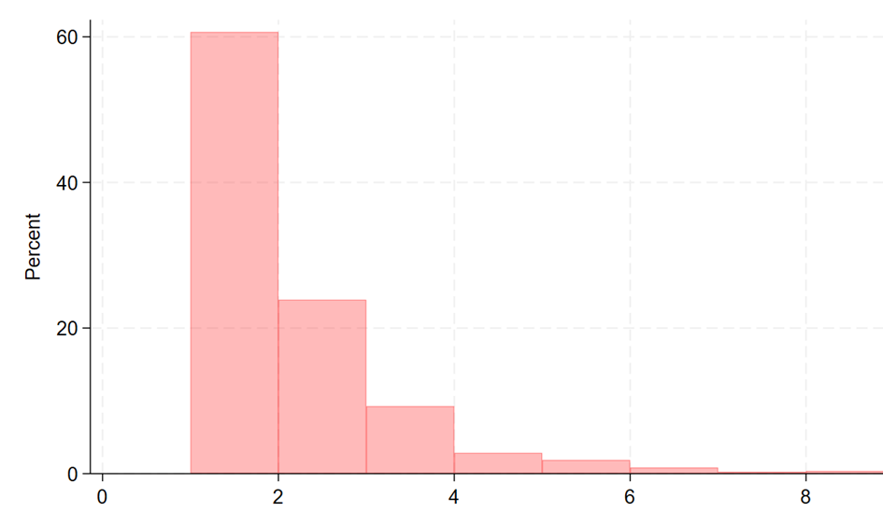
Most migrants go abroad for short periods of time
Duration of stay abroad is about 2 years on average
40 percent of migrants go abroad more than once
Duration of stay abroad of temporary migrants (in months)
Number of stays abroad among individuals who ever migrated internationally
Note. Vertical dashed lines denote median values
Source: World Bank Kyrgyz Migration Survey 2022/23

Slide 11
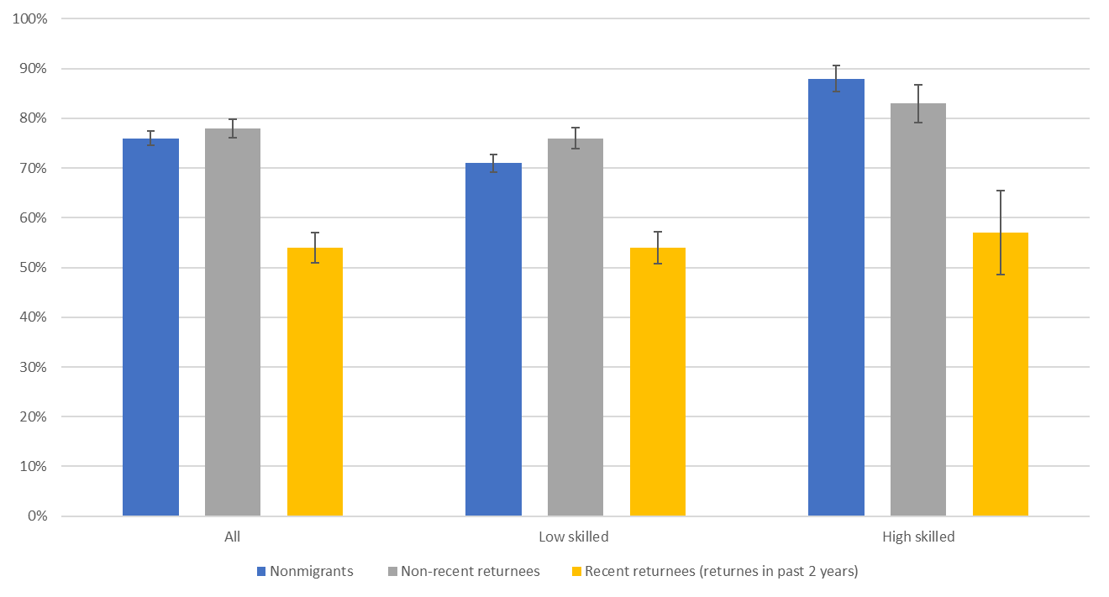
Returnees are initially less likely to be employed than non-migrants, but their employment rates catch up about two years after return
Employment rates of the working age population, by past migration status
Source: World Bank Kyrgyz Migration Survey 2022/23

Slide 12
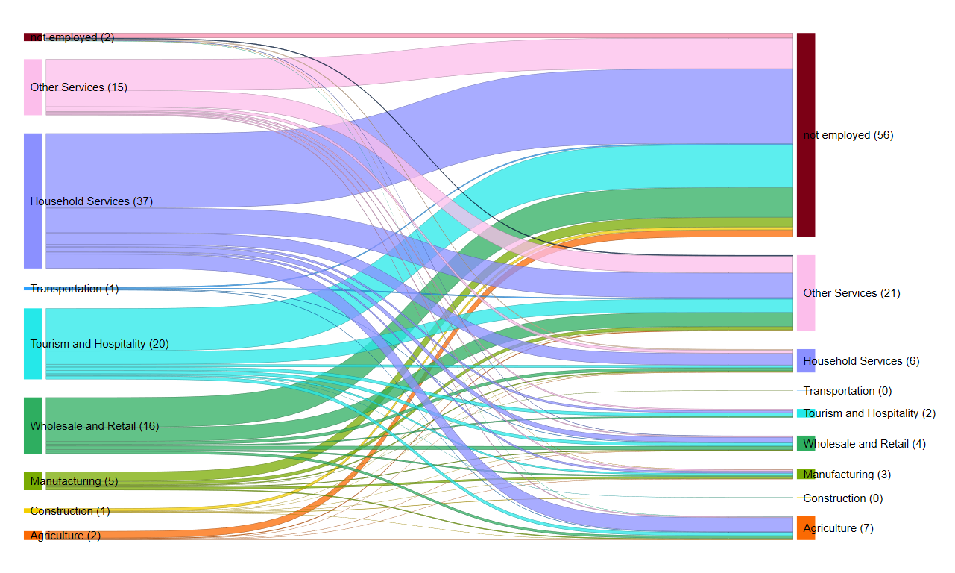
Most female returnees fall back into non employment…
Half of female returnees fall back into non-employment
During migration
After return
Source: World Bank Kyrgyz Migration Survey 2022/23

Slide 13
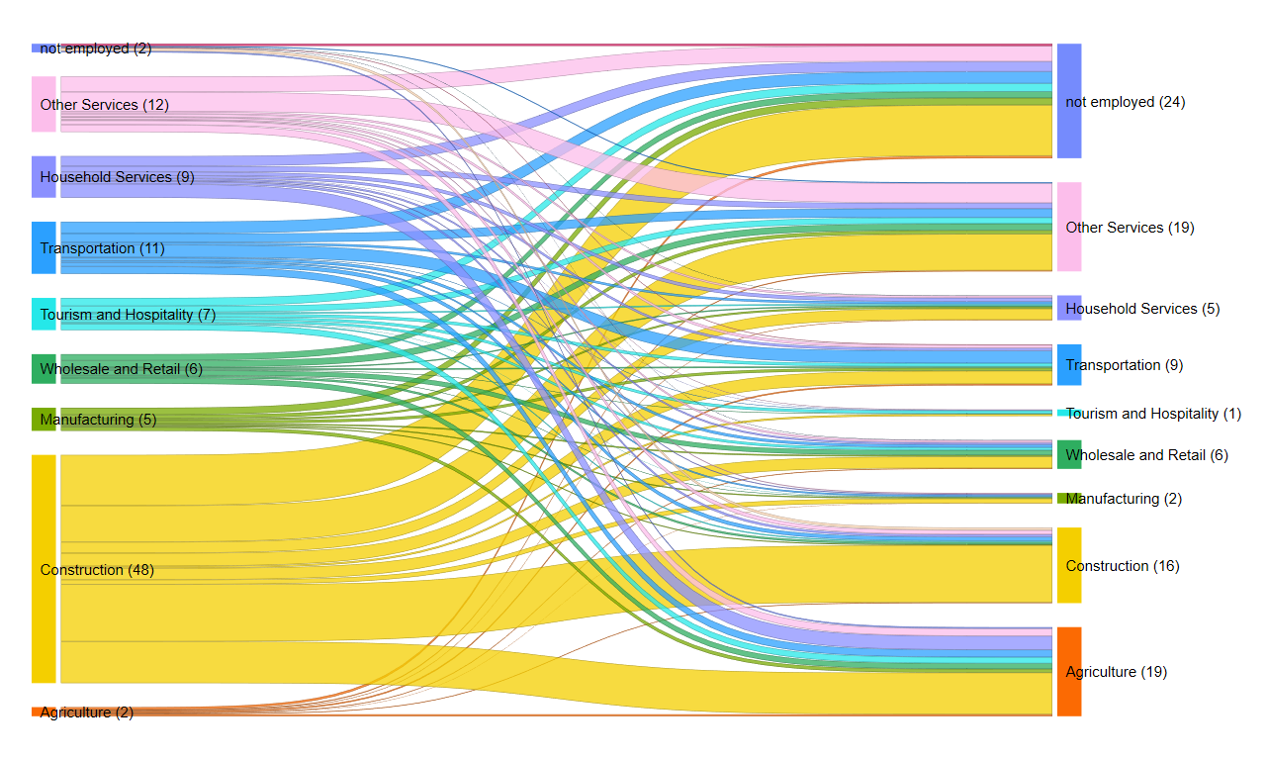
… while many males are employed in sectors that do not match their experience abroad
Most male returnees are employed in sectors that do not match their experience abroad
During migration
After return
Source: World Bank Kyrgyz Migration Survey 2022/23

Slide 14
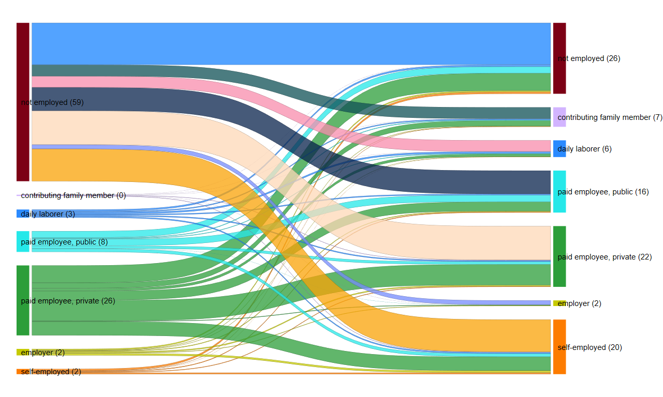
Returnees often transition into self-employment activities after return
Before migration
After return
Source: World Bank Kyrgyz Migration Survey 2022/23

Slide 15
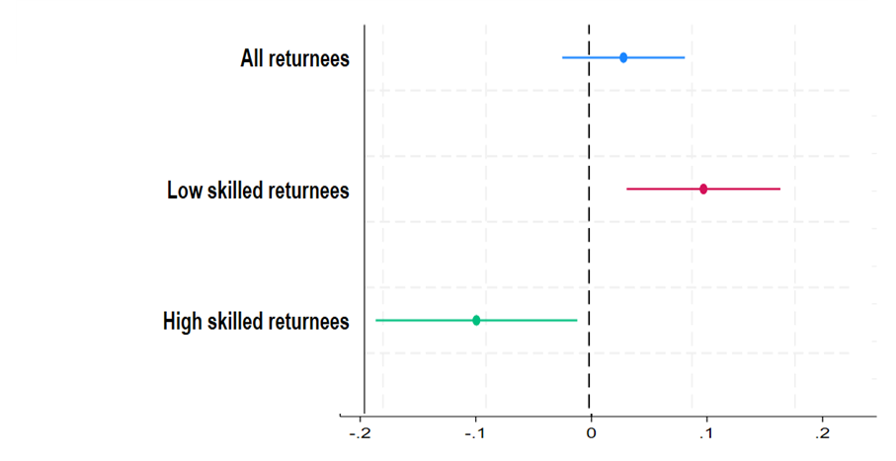
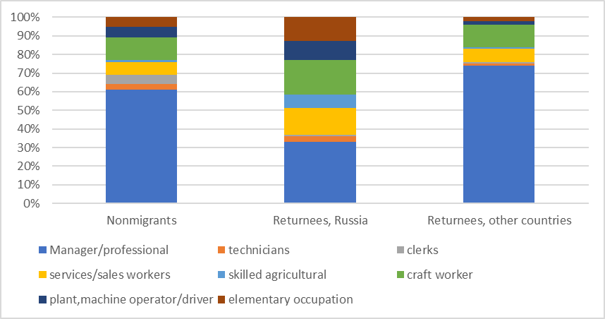
Returnees engaged in wage work often experience occupational downgrade back in the Kyrgyz Republic
Monthly earnings of return migrants relative to non-migrants (in %)
Occupation of tertiary-educated workers
Source: World Bank Kyrgyz Migration Survey 2022/23
Note. The displayed coefficients were obtained by regressing workers’ logged monthly wages in USD2010 (dependent variable) on a returnee dummy (explanatory variable) controlling for workers’ other observable characteristics. The coefficients displayed are OLS coefficients on the male dummy. Horizontal lines represent 95 percent confidence intervals.

Slide 16
Summary of Policy recommendations
Migration can be managed to raise development impacts and reduce costs/vulnerabilities
This can be achieved through policy interventions in four main areas:
1. Increasing migration efficiency and productivity in existing corridors.
2. Diversifying migrants’ occupations and destinations.
3. Reducing vulnerability.
4. Supporting returnees’ reintegration and re-migration.

Slide 17
Policy recommendations
1. Increase migration efficiency and productivity in existing corridors
1.1. Strengthen information provision about migration opportunities
Strengthen the role of public institutions and regulatory frameworks in information provision.
Government-to-Government (G2G) programs provide information about migration opportunities through home country government in close collaboration with destination.
G2G program between Bangladesh and Malaysia/South Korea increased access to migration opportunities for workers without social networks abroad (Mobarak et al. 2023).
Community-based approach to reach migrants in remote rural areas.
Relies on local nongovernmental organizations, community-based organizations and village heads to deliver information and services to potential migrants at the village level.
1.2. Increase migrants’ preparedness for work abroad
Develop orientation programs with financial literacy modules.
Training focuses on financial planning and management, savings and remittances.
Intervention that engage the entire household are more effective (not the migrant alone).
Financial education program for prospective migrants in Indonesia increased migrants’ financial knowledge and savings (Doi, McKenzie, and Zia 2014; Gibson, McKenzie, and Zia 2014).
Partner with destination to train perspective migrants.
Global Skills Partnership Programs (GSPs) where training in home country is partly financed by destination.
e.g: GSPs between Western Balkan countries and Germany.

Slide 18
Policy recommendations (continued)
1. Increase migration efficiency and productivity in existing corridors
1.3. Support formal migration pathways
Establish registries of prospective migrants and potential employers.
e.g. “National Register of Persons with Confirmed Qualifications” with registry of Foreign Employers established in Uzbekistan.
Develop government-led programs regulating the recruitment process of migrants.
G2G programs: home country government manages migrants’ recruitment, in coordination with destinations.
e.g. G2G between Bangladesh and Malaysia significantly improved economic outcomes of migrant workers (Mobarak at al. 2023); Employment Permit System (EPS) between Korea and several origin countries.
Establish seasonal worker programs.
e.g. Recognized Seasonal Employer Program between Pacific Islands and New Zealand.
Migrants receive the same minimum wage and worker rights as native-born workers; they also get formal employment contracts and access to social protection in the destination for the seasonal work period.
Large positive effects on migrant household income, consumption, savings and durable goods (Gibson and McKenzie 2014).
1.4. Reduction occupational downgrade
Develop skill certification/accreditation systems.
Skill assessment and certification systems for migrants established in 2018 in Uzbekistan; Skill testing and accreditation required before being deployed abroad as domestic worker in the Philippines.
Establish Mutual Recognition Agreements (MRA) with destination countries.
MRA signed between India and Singapore in 2017 for nursing.
Empirical simulation suggests measurable economic gains for participating countries (Corong and Aguiar 2019).

Slide 19
Policy recommendations (2)
2. Diversify occupations and destinations
2.1. Identify demand from new destinations and new occupations
Develop monitoring systems on skills in demand by destination countries.
Expand capacity of Ministry of Labor to identify demand for migrant labor.
Coordinate with destinations through data sharing on skill shortages/labor demand.
Establish data management systems to communicate labor needs to prospective migrants.
2.2. Establish Institutional arrangements with new destinations
Bilateral Labor Agreements, Memoranda of Understanding, G2G programs or Global Skills Partnerships (GSPs).
Recent bilateral agreement signed between Uzbekistan and Germany
2.3. Human capital development for migrants
Develop training programs in new occupations based on demand identified.
Expand the capacity and resources of public skill training programs.
Can be supported by destination countries through Global Skill Partnership Programs (GSPs).
In Kosovo, Germany provides technical and financial resources to train prospective migrants in select occupations though GSPs (Clemens and Gough 2018).
Develop/strengthen partnership with private training providers.
Develop language skills among migrants to access new markets.
Uzbekistan offers language courses for prospective migrants in partnership with destinations (e.g. Japan).

Slide 20
Policy recommendations (3)
3. Reduce vulnerability
3.1. Establish mechanisms to protect informal migrants
Private insurance products to insure migrants against job loss at destination.
Establish migrants’ Welfare Funds.
e.g. Welfare Fund for Overseas Workers in the Philippines.
Increase role and capacity of consular sections in providing legal counselling to migrants’ abroad.
3.2. Develop social protection systems for formal migrants
Establish dedicated social protection programs for formal migrants.
Voluntary contribution schemes that provides social security abroad and income security on return.
Social Security System Program for Overseas Migrant Workers in the Philippines.
Develop mechanisms for portability of social insurance across borders.
Establish system where migrants make contributions to have equal access to unemployment benefits and health care as nationals in destination countries.
The Philippines incorporates equal access to social protection and portability of benefits in its bilateral agreements and Memoranda of Understanding (MOUs) with destination countries.

Slide 21
Policy recommendations (4)
4. Support returnees’ reintegration and re-migration
4.1. Develop a strategic plan for migrants’ reintegration
e.g. Albania developed a comprehensive national strategy for migrants’ reintegration.
4.2. Return migrant registration and needs assessment
Establish an administrative registry of return migrants.
Return migrant registry established in Uzbekistan in 2021.
Administer rapid need and plan assessments for returnees at registration points for returnees (one-stop shop).
4.3. Provide services to returnees based on needs assessment
Support to self-employment and entrepreneurship.
Abroad Foreign Worker (OFW) reintegration program provided by the Philippines includes training for those who would like to start up small businesses.
Local demand assessments to identify potential activities for self-employed returnees carried out by some origin countries.
Active labor market policies and job search support (employment services).
Requires increasing resources and capacity of domestic ALMP programs and employment services.
Temporary livelihood support to forced returnees (unexpected returns).
e.g. Bangladesh Emergency cash support program provided to forced returnees during COVID-19.

Slide 22
Thank you!

