Slide 1
Impact of migration on the labor market Leveraging labor mobility for national development

Slide 2
Migration Worker Overview:
1 in 7
people are migrants
USD 717 billion
per year in remittances
164 million
international migrant workers
But sadly, migrants can be vulnerable to exploitation
281 million
international migrants
Notes:
Key points:
More people migrating now than ever before
1 in 7 or 1 billion people are currently on the move
The majority of people that migrate overseas are moving for employment
Sources: UNHCR, 2014; ILO, 2017, 2015; IIE, 2012; UNDP, 2009. Figures are latest available stock estimates – totals for each group at the end of the most recent year for which figures have been produced.
But sadly, migrants can be vulnerable to exploitation

Slide 3
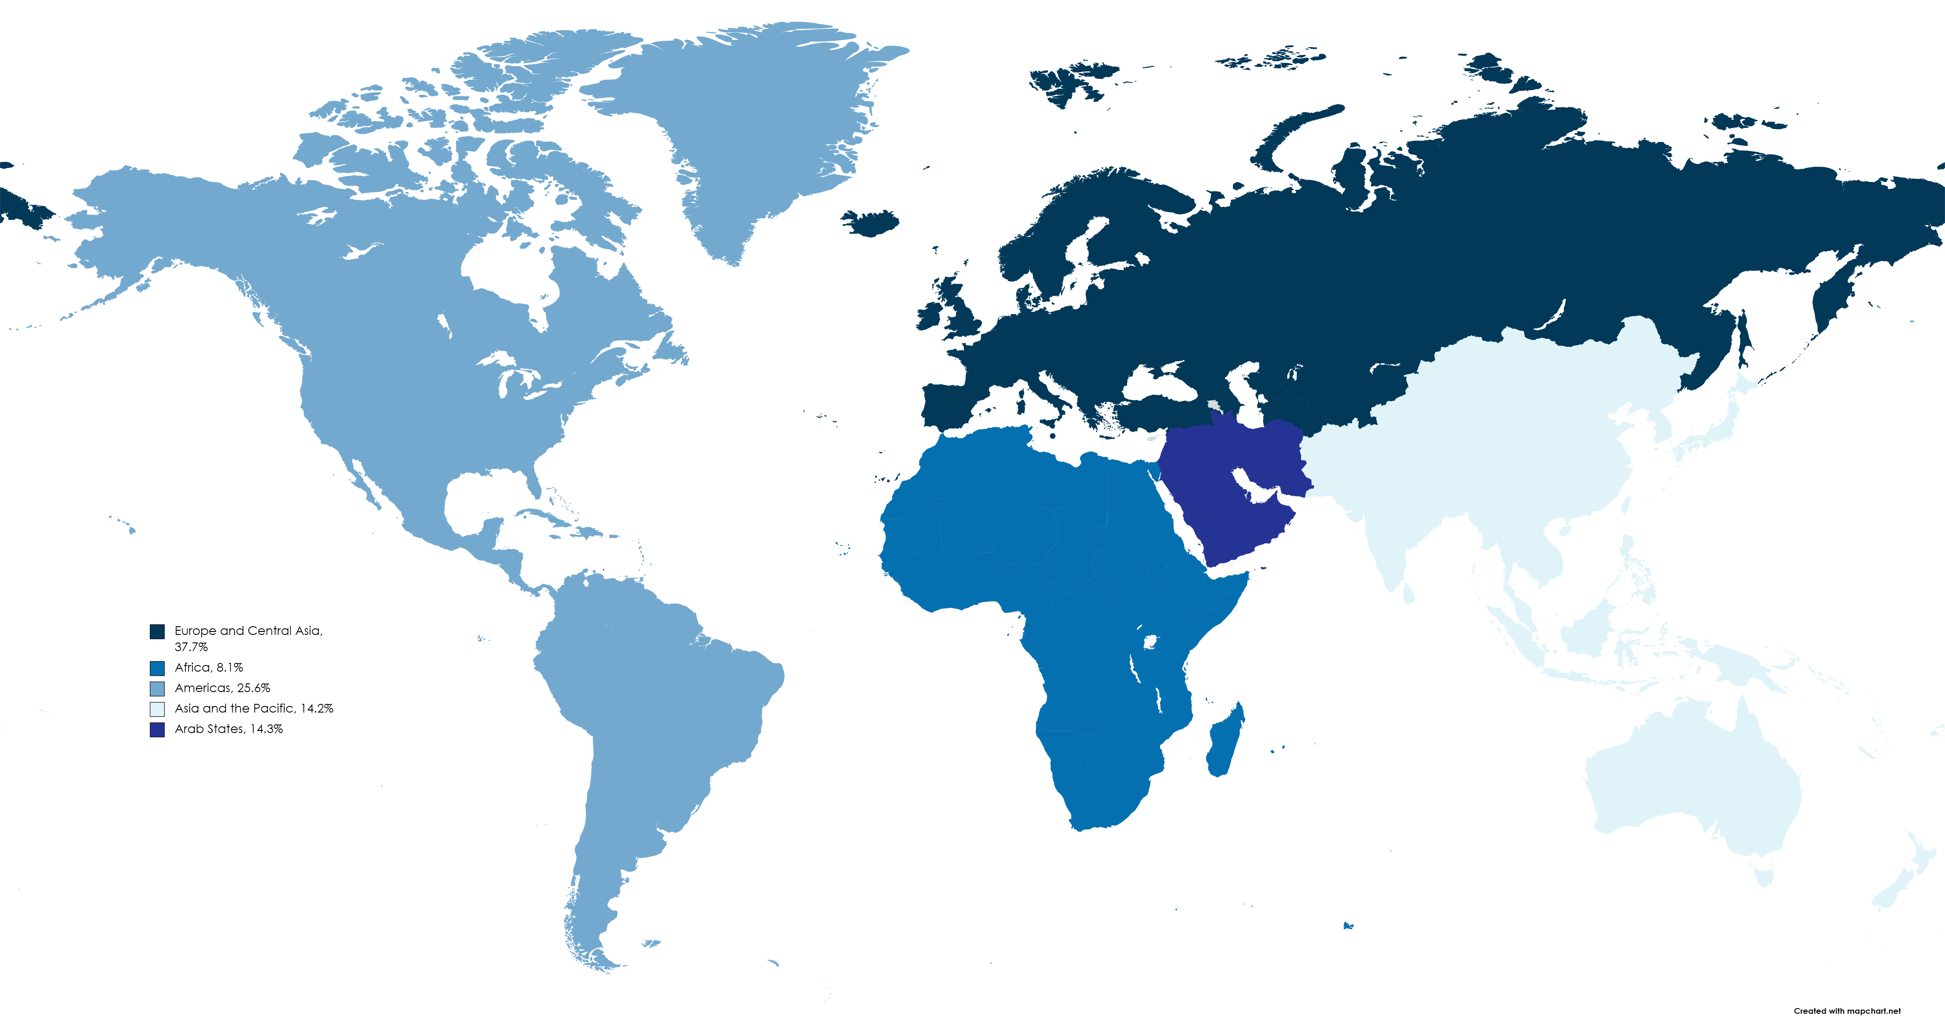
International migrant workers
Europe and Central Asia, 37.7%
Arab States, 14.3%
Africa, 8.1%
Americas, 25.6%
Asia and the Pacific, 14.2%
Source: ILO Global Estimates on International Migrant Workers, 2021
Notes:
Asia and the Pacific represents the fourth most important region in terms of numer of migrant workers, with 14.2% of the total, at the same level as the Arab States.
The world’s 169 million migrant workers are distributed amongst the major regions as follows: Europe and Central Asia, 37.7 per cent; Americas, 25.6 per cent; Arab States, 14.3 per cent; Asia and the Pacific, 14.2 per cent; and Africa, with only 8.1 per cent.
As regards the origin of international migrants, the Asia and Pacific region ranks first (being the region of origin for one-third of international migrants), followed by Europe and Central Asia, the Americas, Asia, and the Arab States.

Slide 4
DRIVERS OF LABOUR MIGRATION
Income and employment differentials
Aging and demographic shifts
Economic transformation and infrastructure development
Technology and automation in the workplace
Climate change
Notes:
The diverse drivers of labour migration – just highlight quickly

Slide 5
Economic impacts of cross-border migration
Cross-border migration currently generates an annual economic output of around $9 trillion
Study of 30 countries, above average labour shortages today cost business more than $1 trillion a year
The direct economic output could more than double by 2050, to around $20 trillion a year
That’s over $3 billion a day – or more than 1% of global economic output
Notes:
Under a consultancy with the Boston Consulting Group (BCG) we lay out the economic business case on the impact of cross-border migration. Economically speaking migration generates massive amount of economic output. Note that study in 30 countries on labour shortages cost business $1 trillion a year and cross – border migratonn currently generates an annual economic output of $9 trillion, with projects for 2050 to be around $20 trillion a year.

Slide 6
In the coming years, the world will need:
10 million health workers by 2030 (WHO)
44 million teachers by 2030 (UNESCO)
30 million new ‘green jobs’ will be created by 2030 (IEA)
2 million workers will be needed in the construction sector in Europe by 2030 (ITUC)
Notes:
Important to note that key sectors will require vast amounts of skills such as health workers, teacher, green jobs and construction just to name a few.

Slide 7
Key Areas of IOM’s Approach to Labour Migration
Enabling Mobility Pathways: Labour and Skills
Skills-Based Mobility
Remittances
Pathways in Humanitarian Contexts and Inclusion
Complementary Pathways
Integration and inclusion
Expanding and Enhancing Labour Migration Opportunities
Employer and intermediary Engagement

Slide 8
REGULAR PATHWAYS ARE:
Legal, policy and regulatory frameworks
Established at multiple levels
Migration
Pre-migration
Stay
Global
Regional
Bilateral
Local
National
Return
Reintegration
Notes:
The slide provides a review of what pathways mean, i.e. the need for vertical alignment of legal and policy framework along with programmes from global all the way down to local.
Pathways are aligned to the migration cycle from pre-migration preparation to movement, stay, return and reintegration.

Slide 9
WHY REGULAR PATHWAYS
Insufficient opportunities for regular migration
Many existing pathways have too few places, are limited to specific geographic areas or only accommodate select population groups
Regular pathways for migrants from developing countries have narrowed over the past 25 years
Existing pathways often do not reach their intended scale or outcomes once they are established
Many people fall into situations of violence, exploitation, abuse and/or irregularity despite having migrated in a regular way
Notes:
We need pathways as we have insufficient opportunities in place for regular migration. Can highlight a few of the points above.

Slide 10
LABOUR MIGRATION PATHWAYS
IOM’s role is as convener, technical service provider and operational actor
This means that IOM is present in all parts of the labour pathway process
IOM is mindful that there is a no-one size fits all and therefore aims to support the necessary advocacy for the entire pathway, after which IOM convenes and provides support as needed
IOM’s engagement with Member States continues through global and regional fora that include, among others:
International Dialogue on Migration (IDM),
Global Forum on Migration and Development (GFMD),
Global Refugee Forum,
Regional Ministerial Forum on Migration for East and Horn of Africa (RMFM),
Colombo Process,
South American Conference on Migration,
Abu Dhabi Dialogue,
Almaty Process
Notes:
Our engagement with Member States will continue through global and regional fora to foster multilateral policy dialogue on various themes relevant to regular pathways, particularly related to the area of skills, bilateral labour migration agreements, remittances and financial for development, social inclusion, displaced talent and diaspora engagement.

Slide 11
Enabling Mobility Pathways: Labour and Skills
LMD UNITS
The unit, in close collaboration with key internal and external partners, works to mainstream skills development, matching, and recognition in labour mobility schemes, so that migrants are able to fully utilize their talents and contribute meaningfully to both their host and home communities.
We do this by promoting a whole of government and whole of society approach in labour migration governance, strengthening data and labour market assessments, supporting intergovernmental coordination (RECs and RCPs), and assisting Member States in the negotiation, implementation and evaluation of Skills Mobility Partnerships and BLMAs.
The unit is committed to elevating its engagement with the private sector, particularly with employers and intermediaries, to facilitate the employment of migrants, including displaced populations, effectively tackling labour shortages by tapping into their diverse skills and innovative solutions.

Slide 12
LMD UNITS
Pathways in Humanitarian Contexts and Inclusion
We will strengthen its approach to providing innovative solutions for displaced talent and other vulnerable migrant groups through more accessible employment and education-based regular migration pathways and sustainable labour market inclusion in host countries. The unit’s mission involves refining IOM's approach to designing and scaling dedicated pathways or making existing regular pathways more accessible, inclusive and appropriate for vulnerable communities
We remain committed to facilitating the inclusion of newcomers in labour markets while fostering social cohesion and connectedness within receiving communities by mobilizing multistakeholder support networks and ecosystems.

Slide 13
LMD UNITS
Diaspora Engagement
IOM’s Diaspora Engagement strategy is centred on three actions: to enable, engage and empower transnational communities, involving interventions by governments and other stakeholders, supported by IOM through policy advice and programming. In missions across the globe, IOM conducts diaspora surveys and mappings, develops capacity building activities, implements outreach initiatives, and develops skills and knowledge transfer programmes.
Embracing migrants and diasporas as catalysts for transformative change, our unit positions them at the forefront of our solutions. Through innovative platforms like iDiaspora and the Global Diaspora Policy Alliance, we partner with diasporas to actively shape policies and programs that advance their employment, talent, and overall development.
Notes:
LMD UNITS: Brief overviews of each Unit, purpose and goals

Slide 14
PATHWAY PHASES
LMD supports the design and operationalization of labour pathways at every phase:
Scoping & Alignment of Interests
Agreement & Establishment of Systems
Recruitment & Intermediary Engagement
Movement & Deployment
Employment & Integration
Return / Onward Movement
Pathway Phase
Employer outreach and engagement
Agree on stakeholders to be involved
Employer outreach and vetting
Facilitate the transfer of talent
Post-arrival orientation
Support with return, reintegration
Example of IOM programming
Stakeholder Engagement & Core Programming continues in every Pathway Phase

Slide 15
THANK YOU

