Slide 1

ASPIRATION FOR LEADERSHIP IN TRAINING SPECIALISTS

Slide 2

Aspiration for leadership in training specialists — is a process in which an individual or a group not only imparts knowledge and skills but also inspires, guides, develops and implements new approaches to learning. Leaders in this field possess not only professional expertise but also qualities that help shape future generations of specialists who are capable of meeting contemporary challenges and contributing to the sustainable development of their industries

Slide 3

KEY TRAITS OF ASPIRING FOR LEADERSHIP IN TRAINING SPECIALISTS:
Vision and strategy: Leaders in specialist training have a clear vision of how their profession and education in the field should evolve. They create strategies aimed at improving the quality of education and developing new approaches that help students be prepared for modern challenges
Creating opportunities for professional growth: Leadership involves not only teaching but also fostering an environment where students can develop their skills. This can include organizing internships, hands-on practice, research opportunities, or participation in international exchange programmes.
Customized approach: Leaders aim to unlock the potential of each student, understanding that everyone needs personalized support and mentorship. Leadership qualities are reflected in their ability to inspire and help individuals grow not only professionally but also personally.
Innovation in education: Leaders in specialist training implement modern teaching methods, including digital technologies, active learning approaches, and the development of critical thinking. They constantly seek to improve educational processes, finding new tools for more effective knowledge acquisition.

Slide 4

KEY TRAITS OF ASPIRING FOR LEADERSHIP IN SPECIALIST TRAINING:
Formation of a culture of continuous learning: A leader in the training of specialists understands that the learning process never stops. They create conditions for specialists to continue improving throughout their careers, teaching them self-learning methods and supporting the idea of lifelong education.
Mentorship and guidance: Mentors and leaders play an important role in the career growth of young specialists. They impart not only technical knowledge but also valuable advice on developing professional qualities, helping students overcome challenges and achieve success.
Ethical leadership: A leader in the training of specialists is also responsible for instilling moral and ethical principles in students. It is important for future professionals not only to possess knowledge but also to understand their social responsibility, act in the interest of society, and uphold a high level of professional ethics
Global perspective: In the context of globalization, a leader in the training of specialists must understand international trends and standards. They educate students to think globally, preparing them to work in various international contexts and adapt to rapidly changing conditions

Slide 5
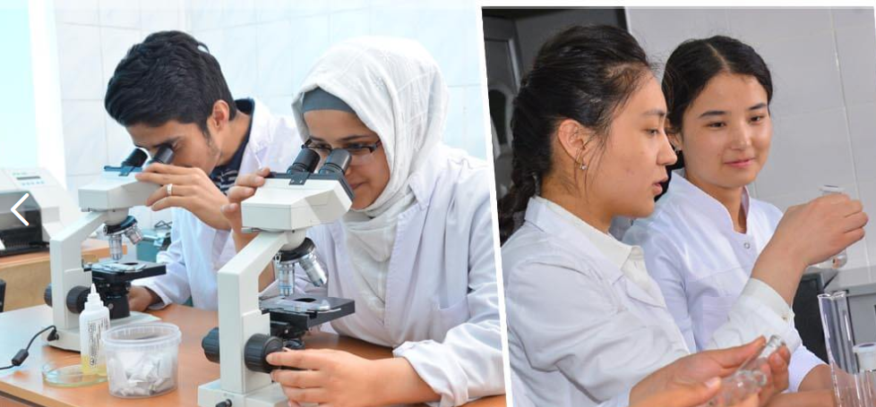
The aspiration for leadership in the training of specialists, such as a physician, is associated with several key aspects that ensure not only professional but also personal growth. For a physician, this is especially important, as the medical profession requires not only knowledge and skills but also leadership qualities, such as the ability to make responsible decisions, work in a team, and communicate effectively with patients and colleagues

Slide 6

Professional competence and the pursuit of continuous learning:
Leadership requires deep knowledge in the field of medicine, and a successful physician-leader will always strive to improve their professional skills. This includes both medical practice and participation in research, seminars and conferences.
Effective communication: An important component of leadership is the ability to convey information clearly and persuasively. A physician needs to communicate effectively with patients, explaining diagnoses and treatment plans, as well as with colleagues when participating in discussions of complex clinical cases
KEY ASPECTS OF LEADERSHIP IN PHYSICIAN TRAINING:
Example for colleagues: A physician-leader serves as a role model for other doctors and medical staff. They demonstrate a high level of professionalism, ethics, and empathy, inspiring the team to achieve high standards in delivering medical care
Decision-making skills in conditions of uncertainty: Leaders in medicine often face situations where it is necessary to make decisions quickly and accurately. The ability to adequately assess risks and choose the best course of treatment for a patient is an important aspect of leadership

Slide 7
Mentorship and guidance. It is important for experienced physicians to help young specialists develop by sharing knowledge and experience. Leadership qualities are demonstrated through supporting the professional growth of colleagues, education and mentorship
Team management: Physician-leaders often lead medical teams, distributing responsibilities and organizing work processes in a way that maximizes the efficient use of resources and time to provide high-quality medical care
KEY ASPECTS OF LEADERSHIP IN PHYSICIAN TRAINING:
Innovation and development: Leaders strive to implement new technologies and treatment methods in medical practice, keeping up with the latest advances in medicine and science

Slide 8

Overall, leadership in physician training is based on professional excellence, personal responsibility, and the desire to improve both one's own skills and the quality of medical care for patients.

Slide 9
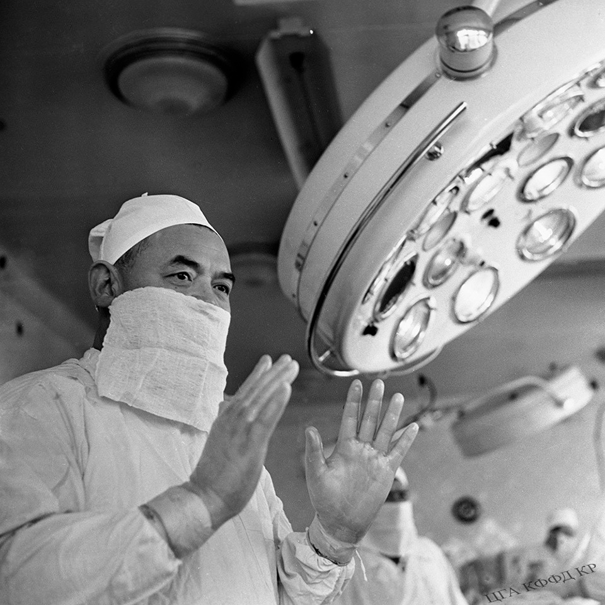
EXAMPLES OF LEADERS IN SPECIALIST TRAINING:
Isa Akhunbaev — his work in the field of surgery and medical education is an example of leadership in physician training in Kyrgyzstan. He trained not only students but also implemented the latest surgical techniques, established new standards in medicine, and became the founder of a leading medical university
THE ASPIRATION FOR LEADERSHIP IN SPECIALIST TRAINING MEANS FORMING A NEW GENERATION OF PROFESSIONALS WHO ARE NOT ONLY CAPABLE OF SOLVING CURRENT TASKS BUT ALSO OF BECOMING LEADERS IN THEIR FIELDS. LEADERS IN SPECIALIST TRAINING ARE THOSE WHO DO NOT SIMPLY IMPART KNOWLEDGE BUT INSPIRE, DEVELOP INNOVATIONS, AND CREATE CONDITIONS FOR LONG-TERM GROWTH AND DEVELOPMENT

Slide 10
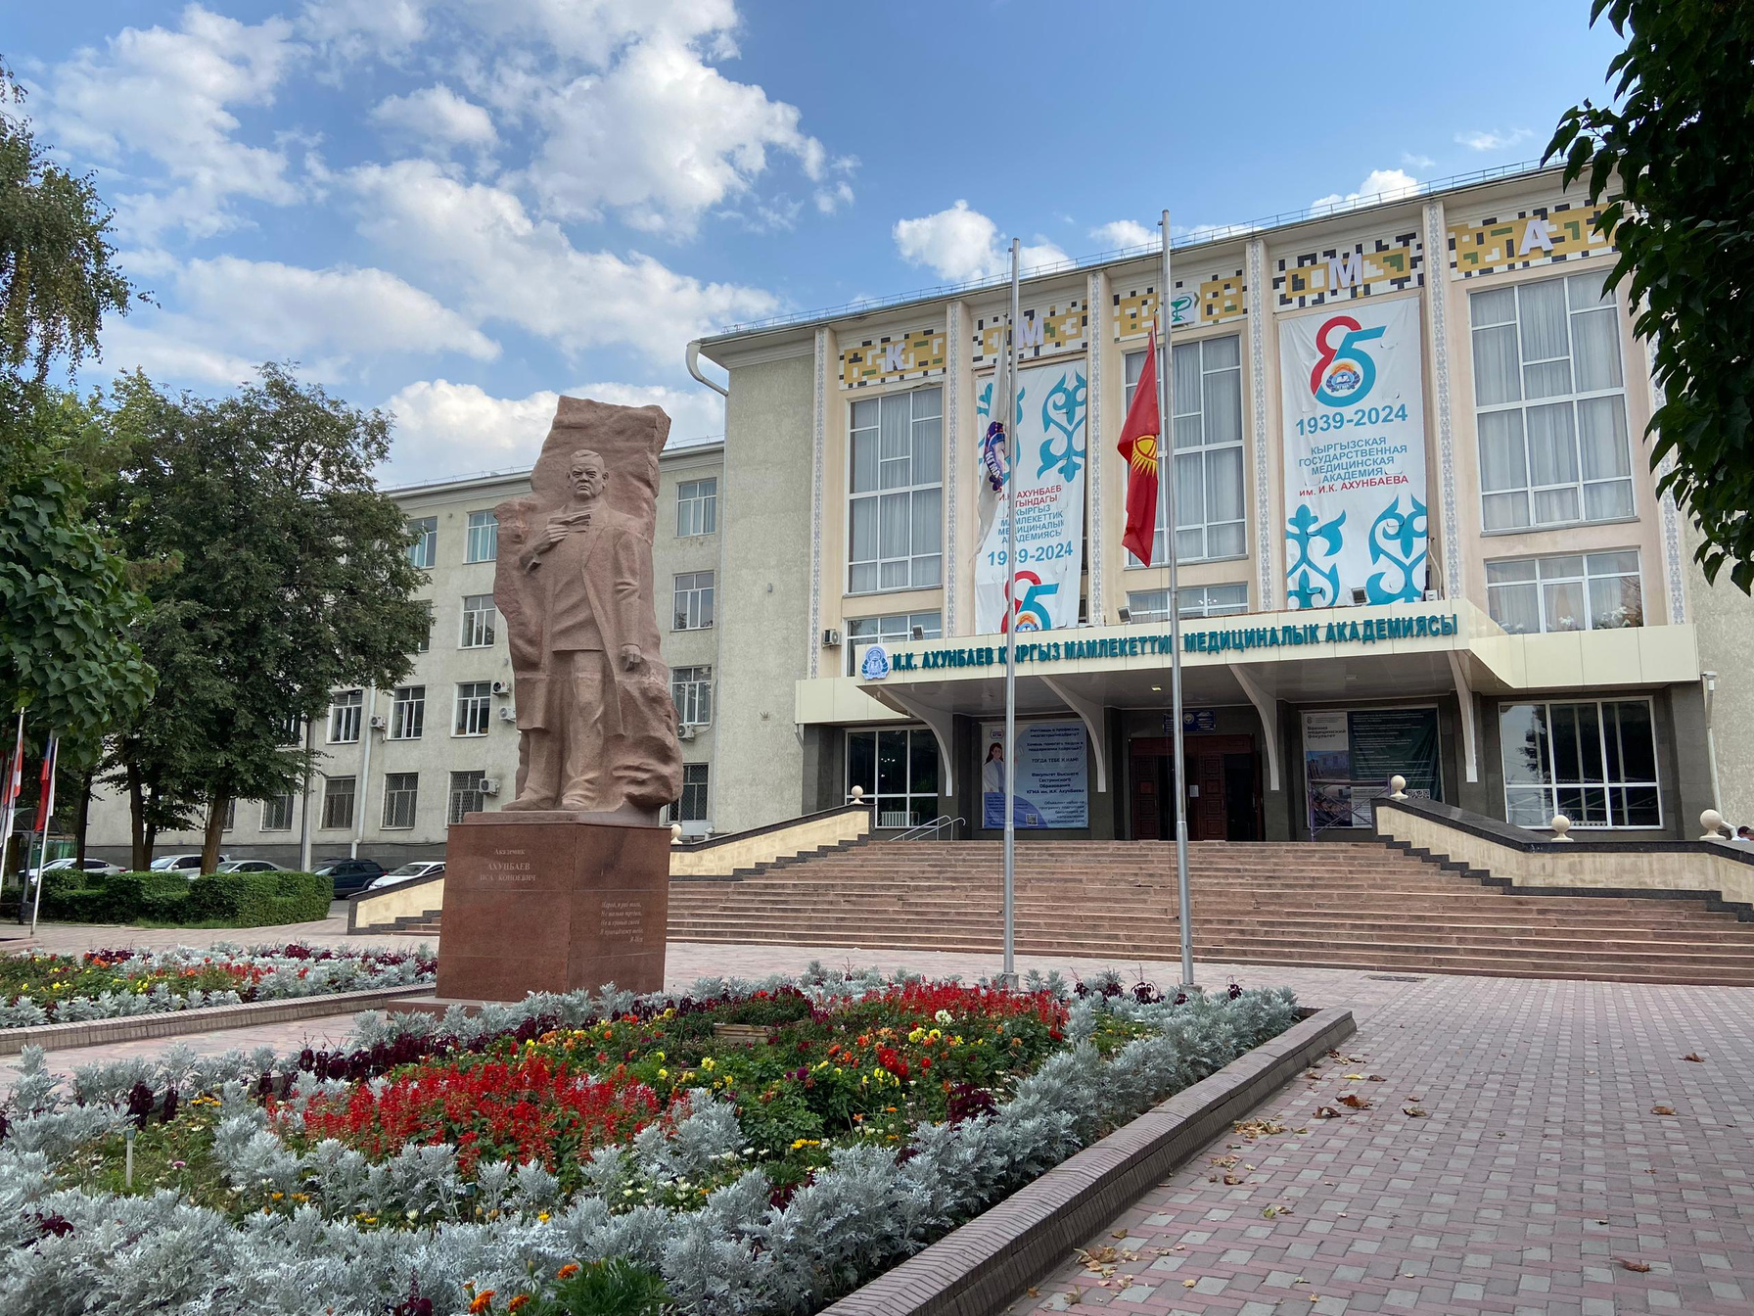
I. K. Akhunbaev Kyrgyz State Medical Academy (KSMU) is rightfully considered a leader in the training of specialists in the field of medicine not only in Kyrgyzstan but also in Central Asia. Since its establishment in 1939, the academy has become an important center for medical education and scientific research, providing high-quality training for medical personnel needed for the healthcare system of the country and beyond

Slide 11

WHY THE MEDICAL ACADEMY IS A LEADER IN SPECIALIST TRAINING:
History of leadership and recognition: The Kyrgyz Medical Academy is named after the great surgeon and founder of medical education in Kyrgyzstan, Isa Konoevich Akhunbaev, who was the first in the country to perform a number of unique surgeries and became a pioneer in the field of medicine. The academy continues his traditions, training specialists who play a leading role in the healthcare system of Kyrgyzstan
A wide range of educational programmes: KSMU offers programmes in various medical specialties, from general medicine to narrow-profile fields such as surgery, pediatrics, dentistry, pharmacy, and many others. Students of the academy receive knowledge that meets international standards, allowing them to successfully work both in Kyrgyzstan and beyond
Support for scientific research: KSMU actively promotes scientific research in the field of medicine. University researchers conduct studies in areas such as cardiovascular surgery, oncology, gastroenterology, infectious diseases, and other fields. This allows students and faculty to participate in cutting-edge medical research and implement new methods of diagnosis and treatment

Slide 12
WHY THE MEDICAL ACADEMY IS A LEADER IN SPECIALIST TRAINING:
Partnerships with international organizations: KSMU maintains close ties with foreign universities and medical institutions. International cooperation allows for the implementation of advanced educational methodologies and standards, facilitates student and faculty exchanges, and enables the implementation of joint research projects. This enhances the academy's leadership as a center for international medical education
Highly qualified faculty: The academy employs leading doctors and scholars, many of whom are recognized not only in Kyrgyzstan but also abroad. The faculty includes doctors of science, professors, and experienced clinicians, which ensures a high level of education. The instructors actively work on developing new curricula and teaching methods, striving for continuous improvement in the quality of education
Implementation of innovative technologies: The academy actively implements modern teaching methods and medical technologies, including simulation trainers, virtual operating rooms, and laboratories. This allows students to develop practical skills before they begin treating patients, improving their professional training and reducing the risk of mistakes

Slide 13
WHY THE MEDICAL ACADEMY IS A LEADER IN SPECIALIST TRAINING:
Emphasis on practical training: Students at KSMU receive not only theoretical knowledge but also extensive practical training in university clinics and hospitals. This gives them the opportunity to interact with patients at early stages of their education and refine their skills under the supervision of experienced physicians
Support for student and graduate development: The academy supports its students and graduates at all stages of their professional journey. Various career development centers operate within the university, helping students find opportunities for internships, research work, and employment after graduation. The academy also promotes further professional development for physicians through postgraduate education programs.

Slide 14

Examples of alumni success:
Many KSMU graduates hold leading positions in medical institutions in Kyrgyzstan and abroad. They are examples of how training at the Medical Academy provides the opportunity to become leaders in healthcare, engaging in both clinical practice and scientific research.

Slide 15

CONCLUSION
The I. K. Akhunbaev Kyrgyz state medical academy — is not just an educational institution; it is a leader in training highly qualified medical specialists, setting high standards for medical education and science in Kyrgyzstan for decades.
The academy contributes not only to the development of professional skills but also to the growth of future leaders in medicine who will shape the future of the country’s healthcare system and promote sustainable development in society.

Slide 16
THANK YOU FOR YOUR ATTENTION!

