Slide 1

Dr Sven Neelsen
Economist (Health)
World Bank
Health, Nutrition, and Population sneelsen@worldbank.org
Out-of-Pocket Healthcare Spending in the Kyrgyz Republic
A Stocktake and Policy Options

Slide 2
Out-of-Pocket Healthcare spending still accounts across the world
Health financing mix
Household out-of-pocket health spending
Payments for uninsured health services and goods
Deductibles and copayments for insured health services and goods
Pre-paid health spending
Government financing
Social health insurance contributions
Voluntary health insurance contribution
External aid
Out-of-pocket vs pre-paid healthcare spending

Slide 3
Out-of-Pocket Health Spending diminishes Human Capital and Economic Growth
Households with less money to invest in productive purposes
Households exposed to financial hardship from OOP health spending – OOPs that form high share of household income or are impoverishing
Healthcare spending needs
Timing unpredictable
Amount unpredictable
Often very high
Inequitable –disproportionate among poor, women
Households forced to spend less on essential goods like food, education, shelter
If pre-paid coverage for healthcare is missing
Reduced economic growth
Many households cannot fully self-insure health spending needs
Reduced human capital
Households forgoing healthcare services they need because they are unaffordable
Poor health outcomes, especially among poor and vulnerable

Slide 4
High levels of OOP health spending lead to financial hardship and poor access to services
High service coverage
Global
Other Central Asian countries
Kyrgyz Republic
Source: Tracking Universal Health Coverage: 2023 Global Monitoring Report
Source: Tracking Universal Health Coverage: 2023 Global Monitoring Report and Global Health Expenditure Database

Slide 5

How can we reduce high OOP health spending?
* Universal coverage, enrollment not tied to contributions
* Comprehensive benefits package, including outpatient medicines
* Avoid copayments, if copayments, use annual caps and broad exemptions
* Improve care quality (investments, training, incentives)
* Sufficient funding for care to reduce informal payments
* Reference pricing for medicines
* Centralized procurement of medicines
* Preferential tax treatment of medical goods
* Incentivize and enforce generic substitution of medicines and ensure quality of generics
* Provide sufficient income and align provider incentives with rationale care use
* Educate patients on rational use of specialist care and medicines
* Establish and enforce gatekeeping to services
* Prescription requirements for medicines
Expand healthcare coverage
Reduce prices of medicines that require copayments
Rationalize care use

Slide 6

How can we reduce high OOP health spending?
* Universal coverage, enrollment not tied to contributions
* Comprehensive benefits package, including outpatient medicines
* Avoid copayments, if copayments, use annual caps and broad exemptions
* Improve care quality (investments, training, incentives)
* Sufficient funding for care to reduce informal payments
* Reference pricing for medicines
* Centralized procurement of medicines
* Preferential tax treatment of medical goods
* Incentivize and enforce generic substitution of medicines and ensure quality of generics
* Provide sufficient income and align provider incentives with rationale care use
* Educate patients on rational use of specialist care and medicines
* Establish and enforce gatekeeping to services
* Prescription requirements for medicines
Expand healthcare coverage
Reduce prices of medicines that require copayments
Rationalize care use

Slide 7
Coverage Expansions are best financed by Public Health Spending
Countries with low OOP have public health spending of > 5% of GDP
Source: Global Health Expenditure Database

Slide 8

How can we pay for Coverage Expansions?
1
Savings – Increasing the efficiency of public health spending
Increase Efficiency
Cost-effectiveness main criterion for benefits package design
Improved targeting of user fee exemptions
Focus on poor and vulnerable
Efficient care delivery model
Disease prevention, early detection, management at primary care level, enforce guidelines and gatekeeping, generic substitution of medicines
Provider payment mechanisms that foster productivity, quality and equity
Reduce redundancies
Unused hospital beds, facilities with low caseloads
…

Slide 9





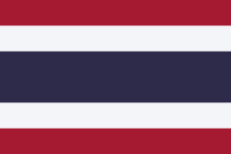


How can we pay for Coverage Expansions?
2
Prioritize health – Increasing the share of total government spending used for health
Average
Note: Graph shows distribution of public healthcare spending share in general government spending across all countries worldwide as of 2019.
Source: Global Health Expenditure Database

Slide 10
How can we pay for Coverage Expansions?
3
Increase Revenues – Higher Taxes and Social Insurance contributions for health
Taxes
Social Health Insurance Contributions
Envelope for public pre-paid Health Coverage

Slide 11
How can we pay for Coverage Expansions?
3
Increase Revenues – Higher Taxes and Social Insurance contributions for health
Taxes
Social Health Insurance Contributions
Envelope for public pre-paid Health Coverage
What about health taxes?

Slide 12
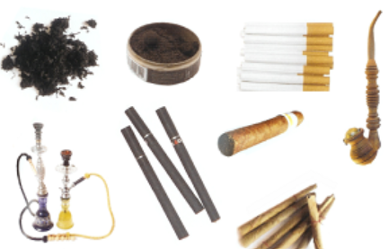



Health Taxes
Tobacco
Alcohol
Ultra-processed foods
Sugar-sweetened beverages (SSBs)
Health Taxes
…

Slide 13
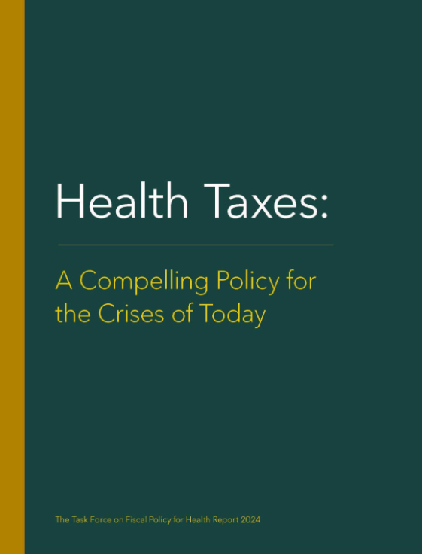
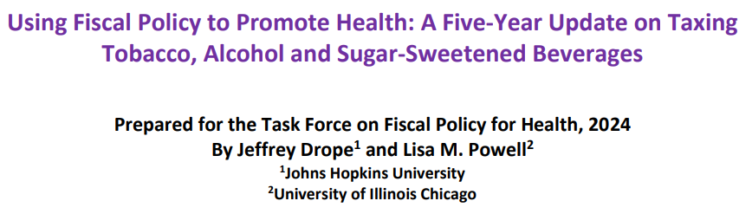
Health Taxes
Tobacco
Alcohol
Ultra-processed foods
Sugar-sweetened beverages (SSBs)
Health Taxes
…
Impacts depends on tax rate &
structure, level &
elasticity of consumption
Prices
Tax evasion and avoidance typically do not offset impacts on consumption and tax revenue
Tax revenue
Revenues vary across countries,
on average : 0.6% of GDP for tobacco,
0.3% for alcohol, <0.1% of SSBs
Consumption
Especially when affordability reduced
Health
Reduce NCD burden
Public spending
Health, policing,
justice, correction
https://www.bloomberg.org/public-health/building-public-health-coalitions/task-force-on-fiscal-policy-for-health/
Jobs

Slide 14
Health Taxes
Tobacco
Alcohol
Ultra-processed foods
Sugar-sweetened beverages (SSBs)
Health Taxes
…
Impacts depends on tax rate &
structure, level &
elasticity of consumption
Prices
Tax evasion and avoidance typically do not offset impacts on consumption and tax revenue
Tax revenue
Revenues vary across countries,
on average : 0.6% of GDP for tobacco,
0.3% for alcohol, <0.1% of SSBs
Consumption
Especially when affordability reduced
Health taxes can generate tax revenue (for health) but are primarily a tool to improve health and reduce healthcare costs
Health
Reduce NCD burden
Public spending
Health, policing,
justice, correction
https://www.bloomberg.org/public-health/building-public-health-coalitions/task-force-on-fiscal-policy-for-health/
Jobs

Slide 15
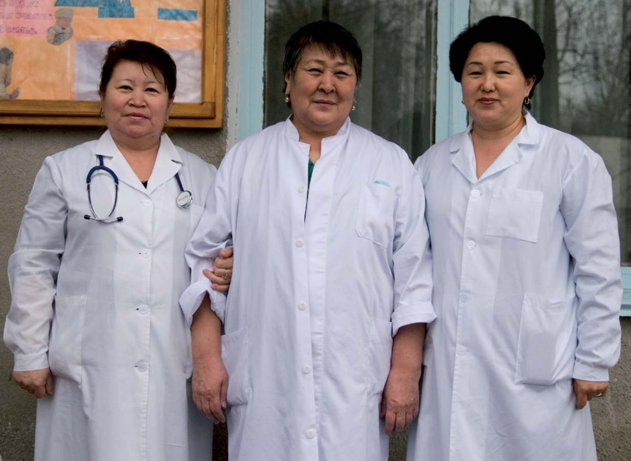
Thank you for your attention !
Don’t hesitate to reach out – sneelsen@worldbank.org

